Slide 1
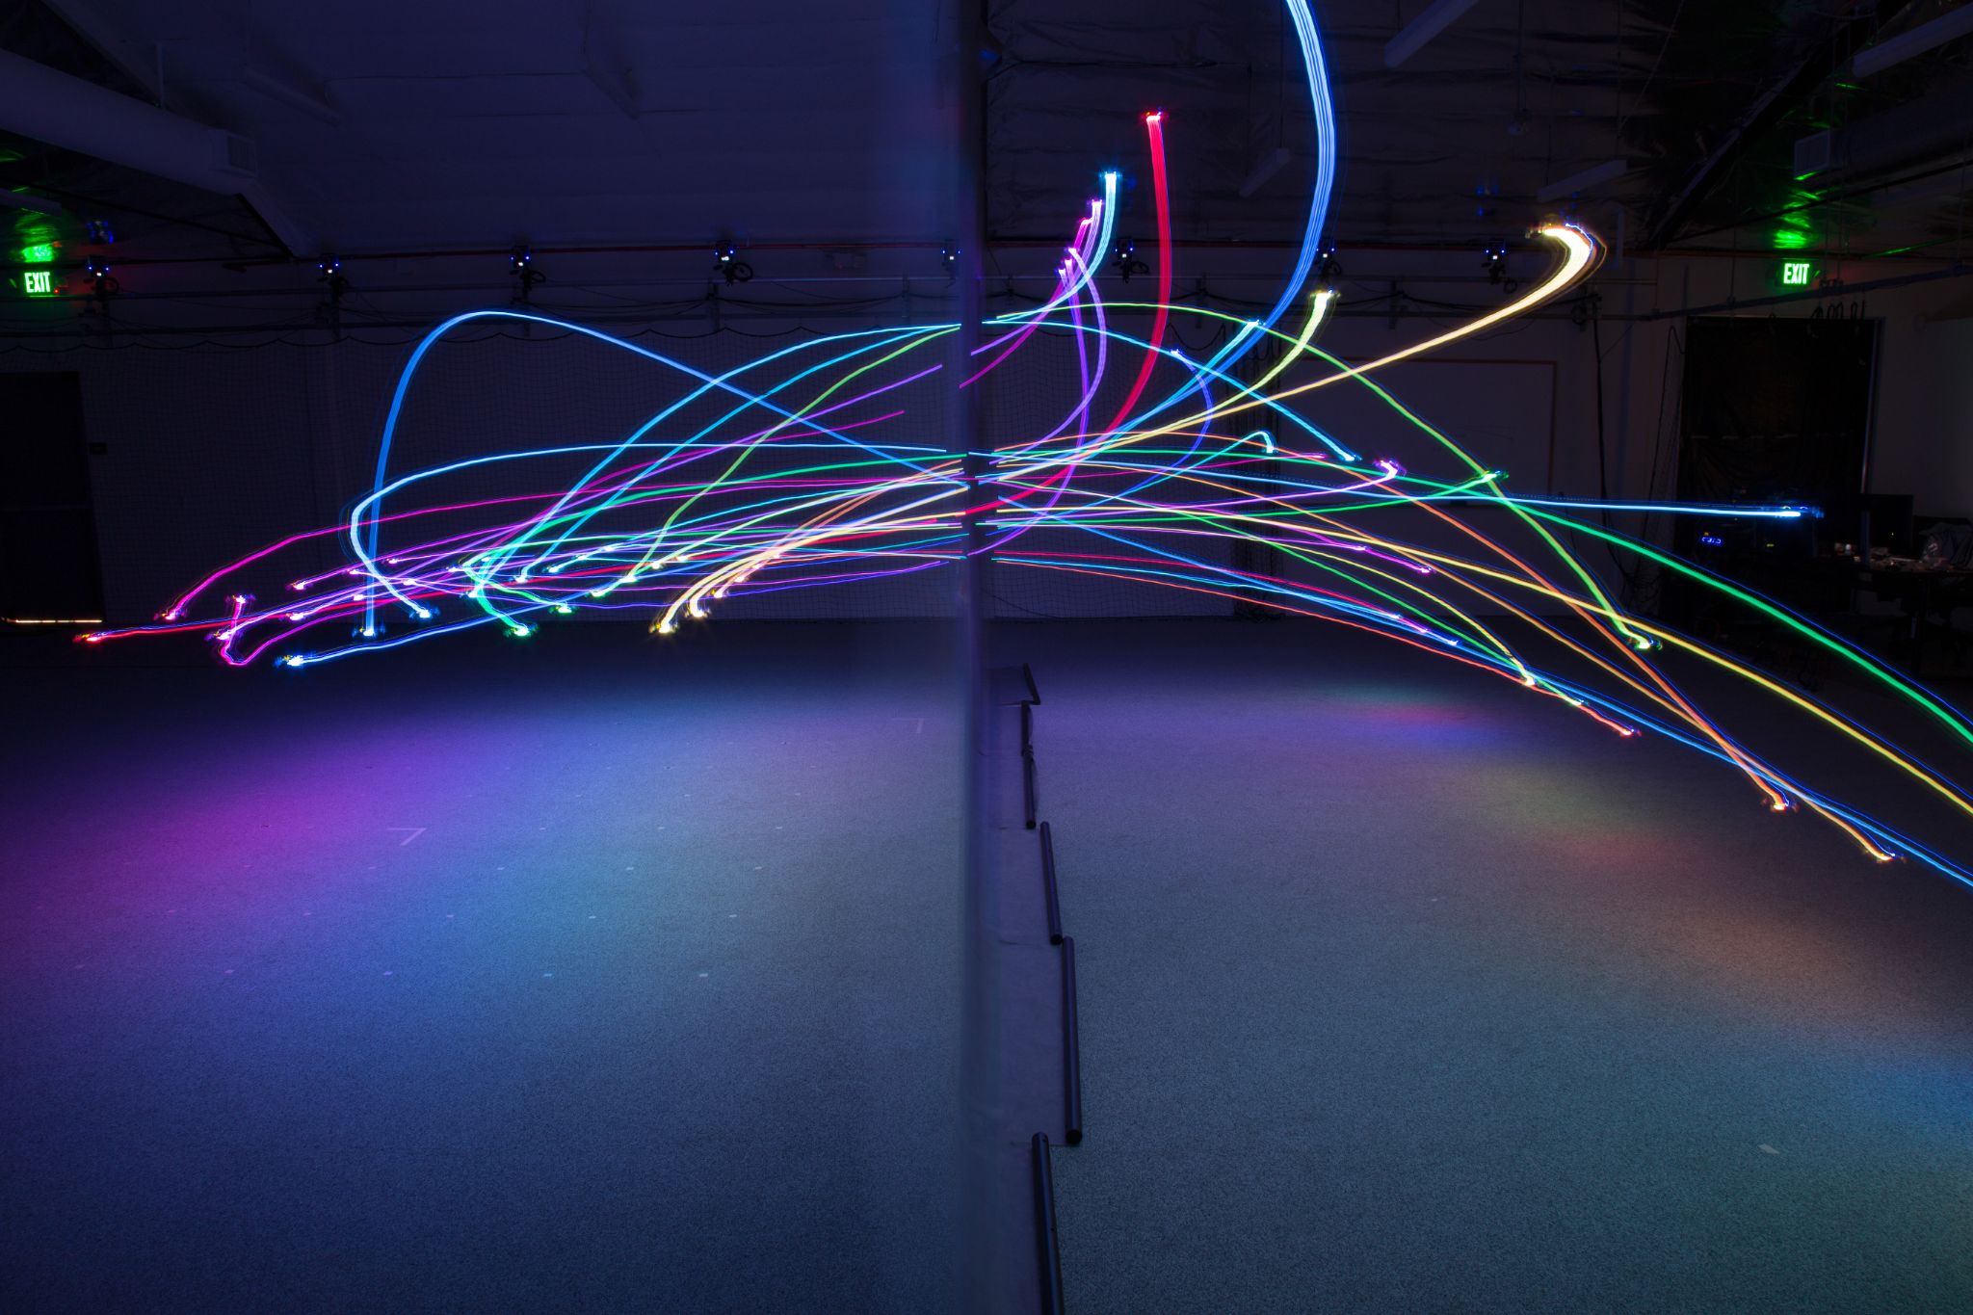
Aerial Robotics
Crazy project
Grégoire Bergamo
Shadi Naguib
Nikitas Papadopoulos
■
June 1st 2021

Slide 2

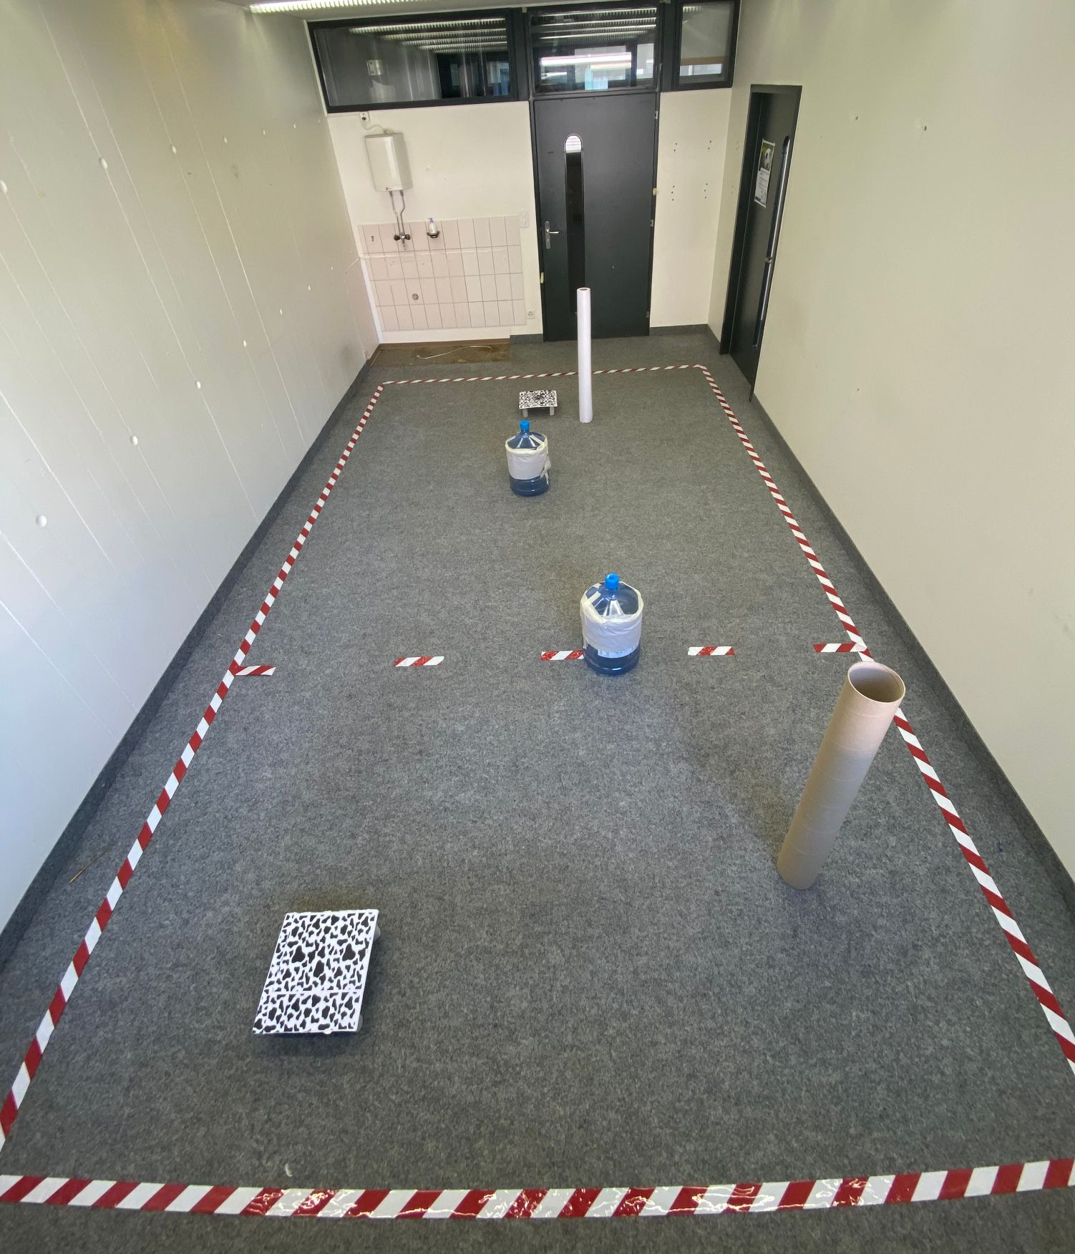
Environmental setup
Take off pad
Cow pattern on pads
Cylindrical obstacles of different sizes
Real-sized arena
Carpet pattern on floor
Obstacle
Landing region delimitation
Obstacle
Landing pad

Slide 3
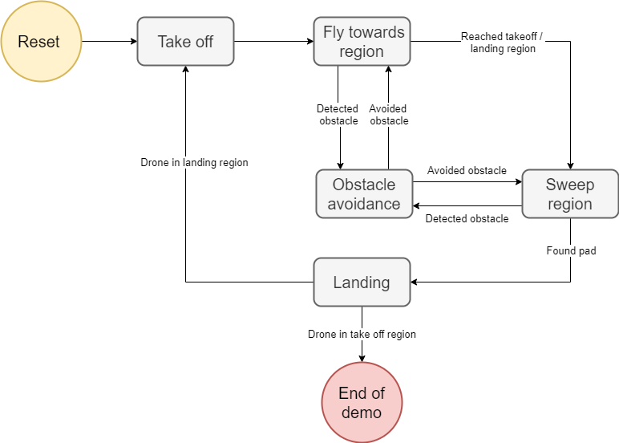
Strategy
State machine
Always re-adjusting position
Different sweeping regions
Robust landing method
Wall following obstacle avoidance

Slide 4
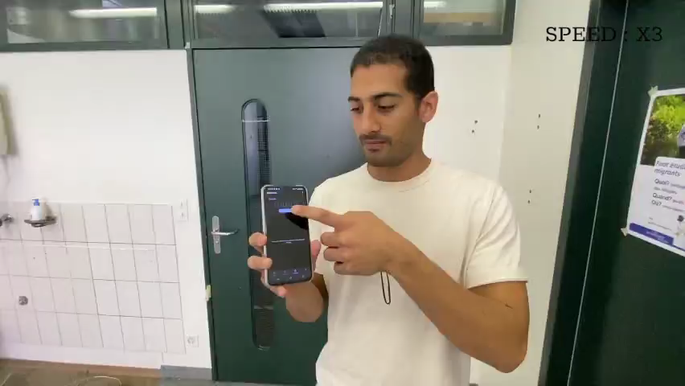
Results
Demonstration
Avoids all types of obstacles
Always finds landing and takeoff pads
Can fly fast and still maintain precision
Stats: 9/10 landing in end region
8/10 landing in start region
2:40 average time per run
27 broken propellers

Slide 5
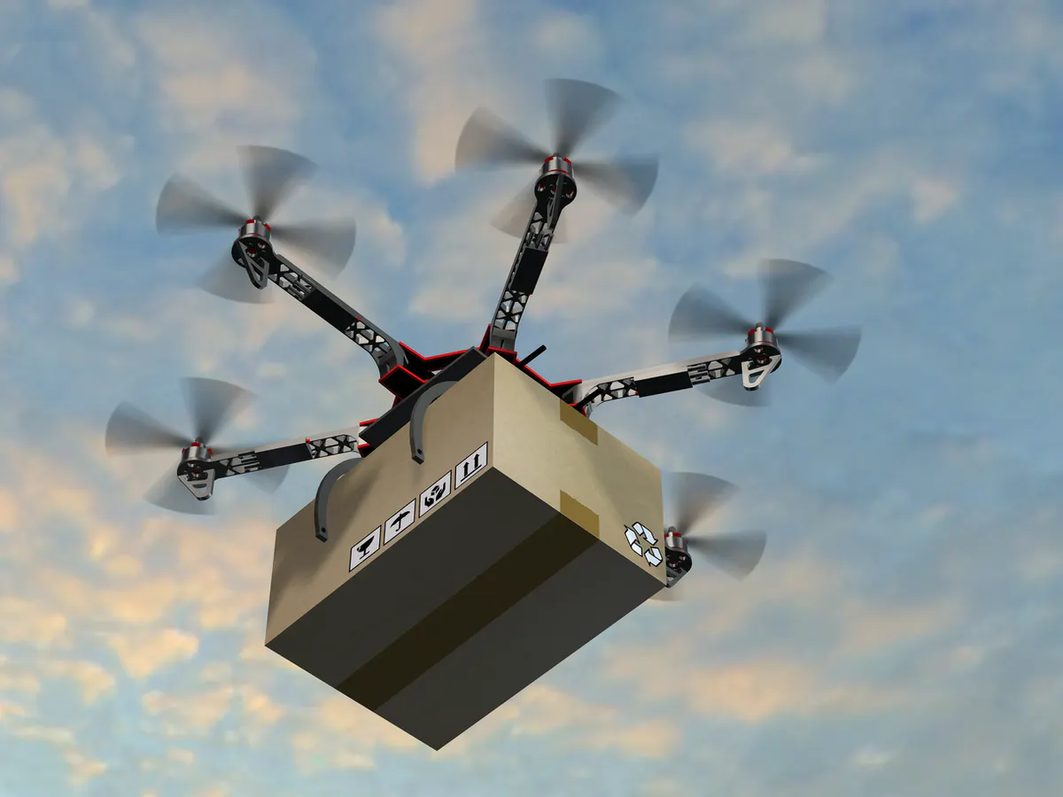
Extra slide - Specificities
Take-off region sweep adds robustness
Trial-and-error approach for avoidance and landing thresholds
Ability to choose which is the best way to avoid obstacles

Slide 6
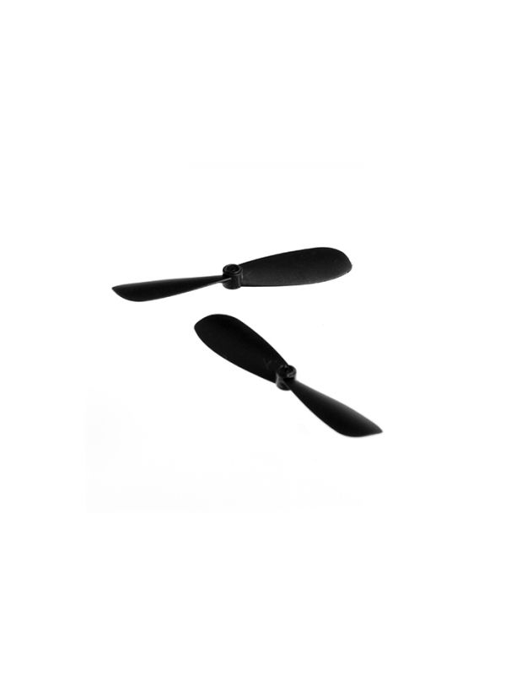
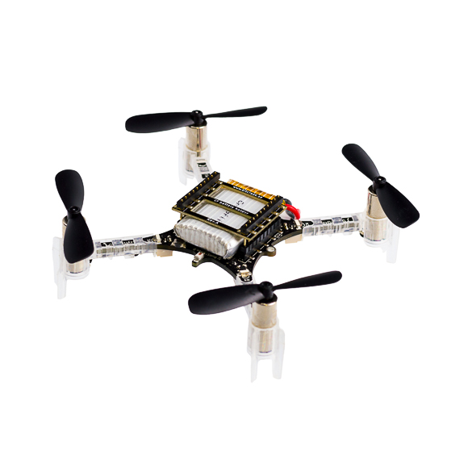
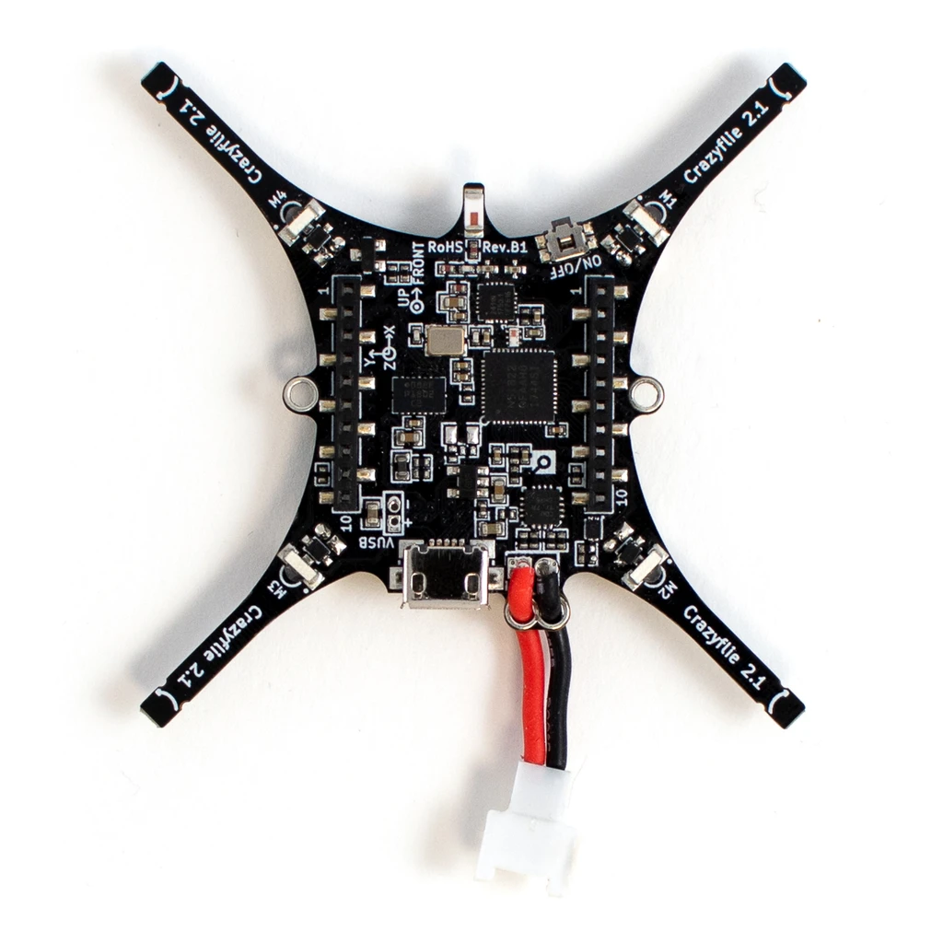
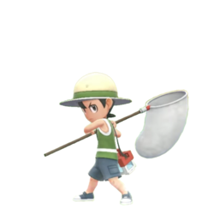

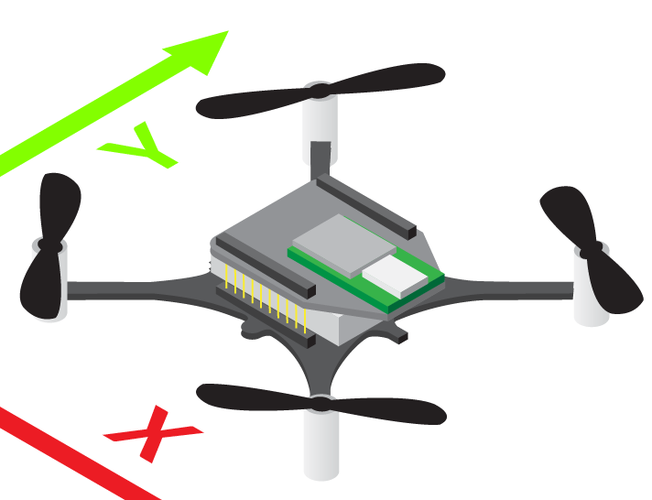
Thank you for this crazy project!

